Slide 1
UV Endstation Fitter Tool
A better name is Yet to be determined

Slide 2
Outline
High-Level Overview
Motivation
Definitions
Examples
Object-Based Approach
SingleScan class
Spectrum class
StitchedSpectrum class
Plotting Methods
Fitting Functions

Slide 3
High Level Overview
I have some data: backgrounds and scans
I give the program the data
I tell the program to plot and / or fit the data
I export my plots and / or fitted parameters
I am happy and never sad ever again :)

Slide 4
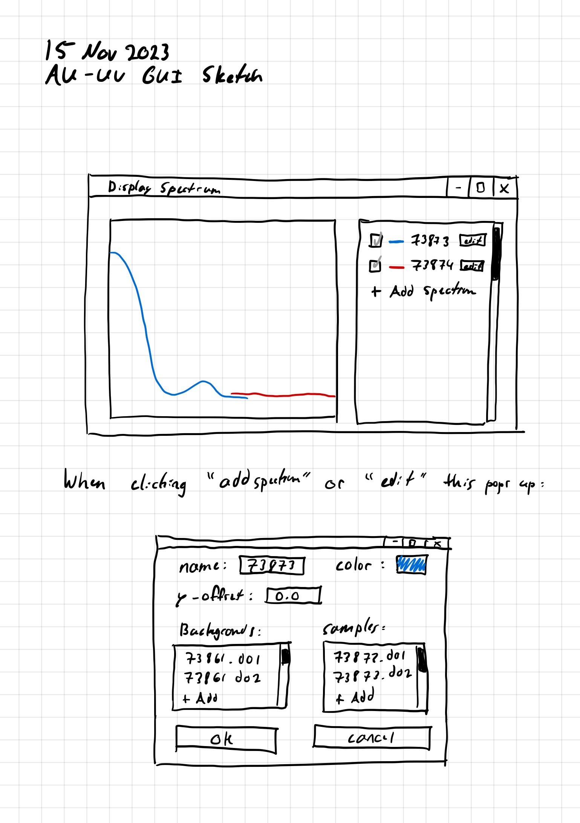
Motivation
Create an easy to use GUI for the UV endstation
Maybe have feature parity with the excel sheets (distant goal)
The user should have to press as few buttons as possible

Slide 5
Important Definitions
Background: A file ending in .d01 or similar, which contains data for a physical spectrum taken of whatever thing on the substrate you want to use as a background.
Sample: A file ending in .d01 or similar, which contains data for a physical spectrum taken of whatever ice you have on the substrate. Samples are calibrated with backgrounds. Samples in the context of this presentation/tool means the data file, NOT the physical ice in the laboratory that is being scanned.
Scan: The combined data of a background and a sample. Or, a sample that has been calibrated with a background. Or, a background with no corresponding sample. The “scan” when using the excel file is the line that shows up when you put data into half of a sheet.

Slide 6
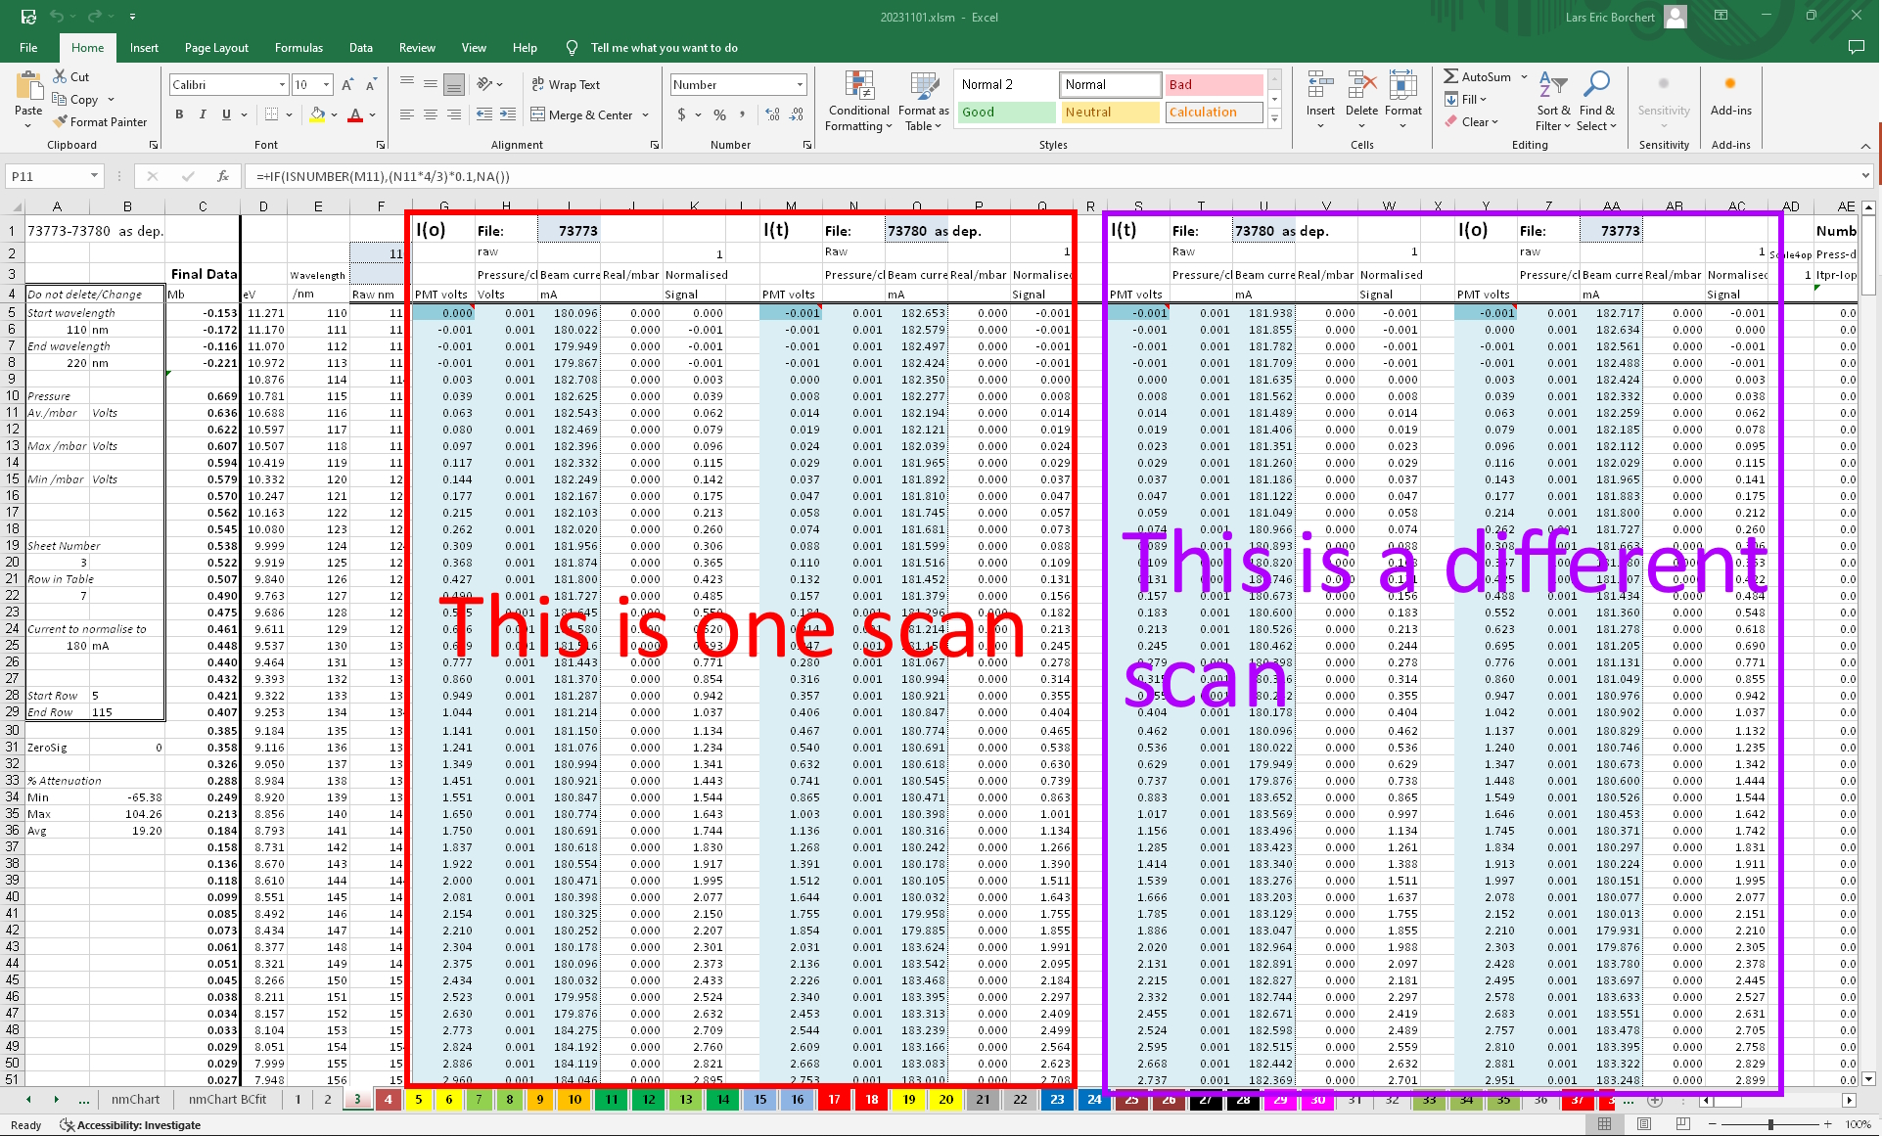

Slide 7
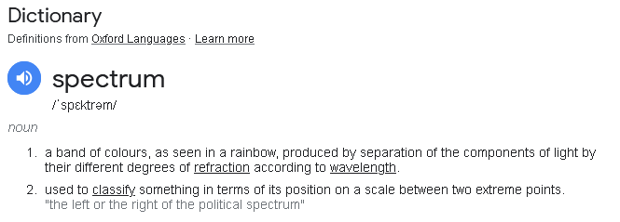
Important Definitions
A Spectrum
A Spectrum Object
Is written in the Consolas font, and in blue for this presentation
Is a specific type of object in the program which represents one or more scans
It contains data that correspond to a spectrum as defined normally
It contains lots of other things too! A name, a color for plotting, parameters after fitting, etc.

Slide 8
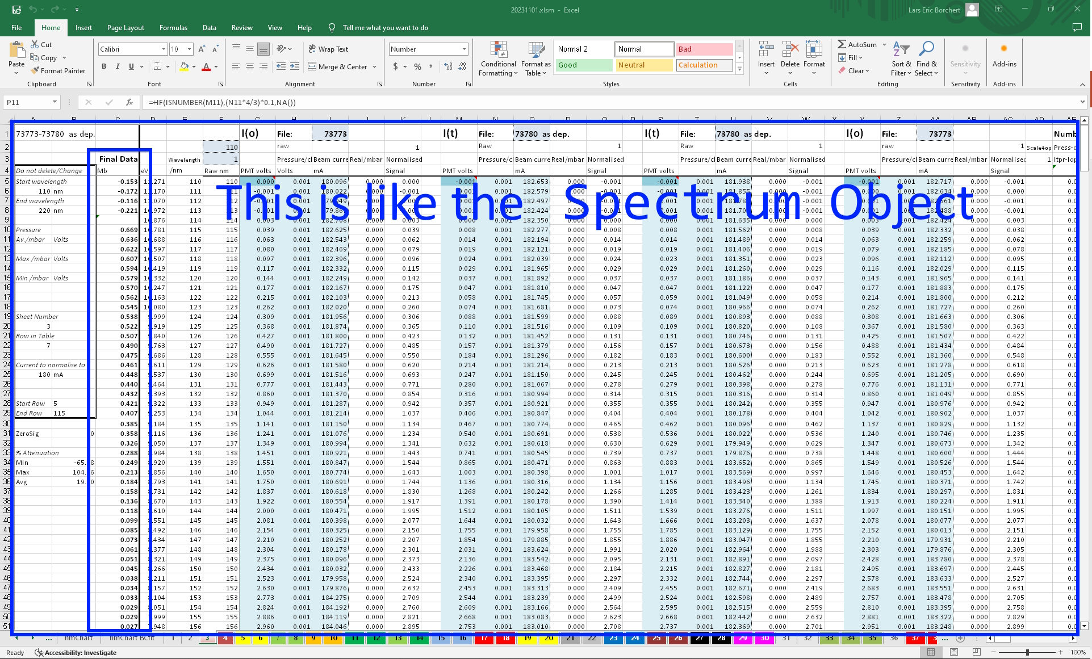

Slide 9
Important Definitions
A Spectrum Object
Represents a combination of scans, all of which are in the same wavelength range
Is like *one* sheet in the excel file, although it can have more than two scans
A StitchedSpectrum Object
Represents a combination of scans, which may or may not be in the same wavelength range.
Only two wavelength ranges are supported
A StitchedSpectrum object is made up of two Spectrum objects
StitchedSpectrum extends the Spectrum class
Is like *two* sheets in the excel file
There will be more information about the object/class structures later

Slide 10
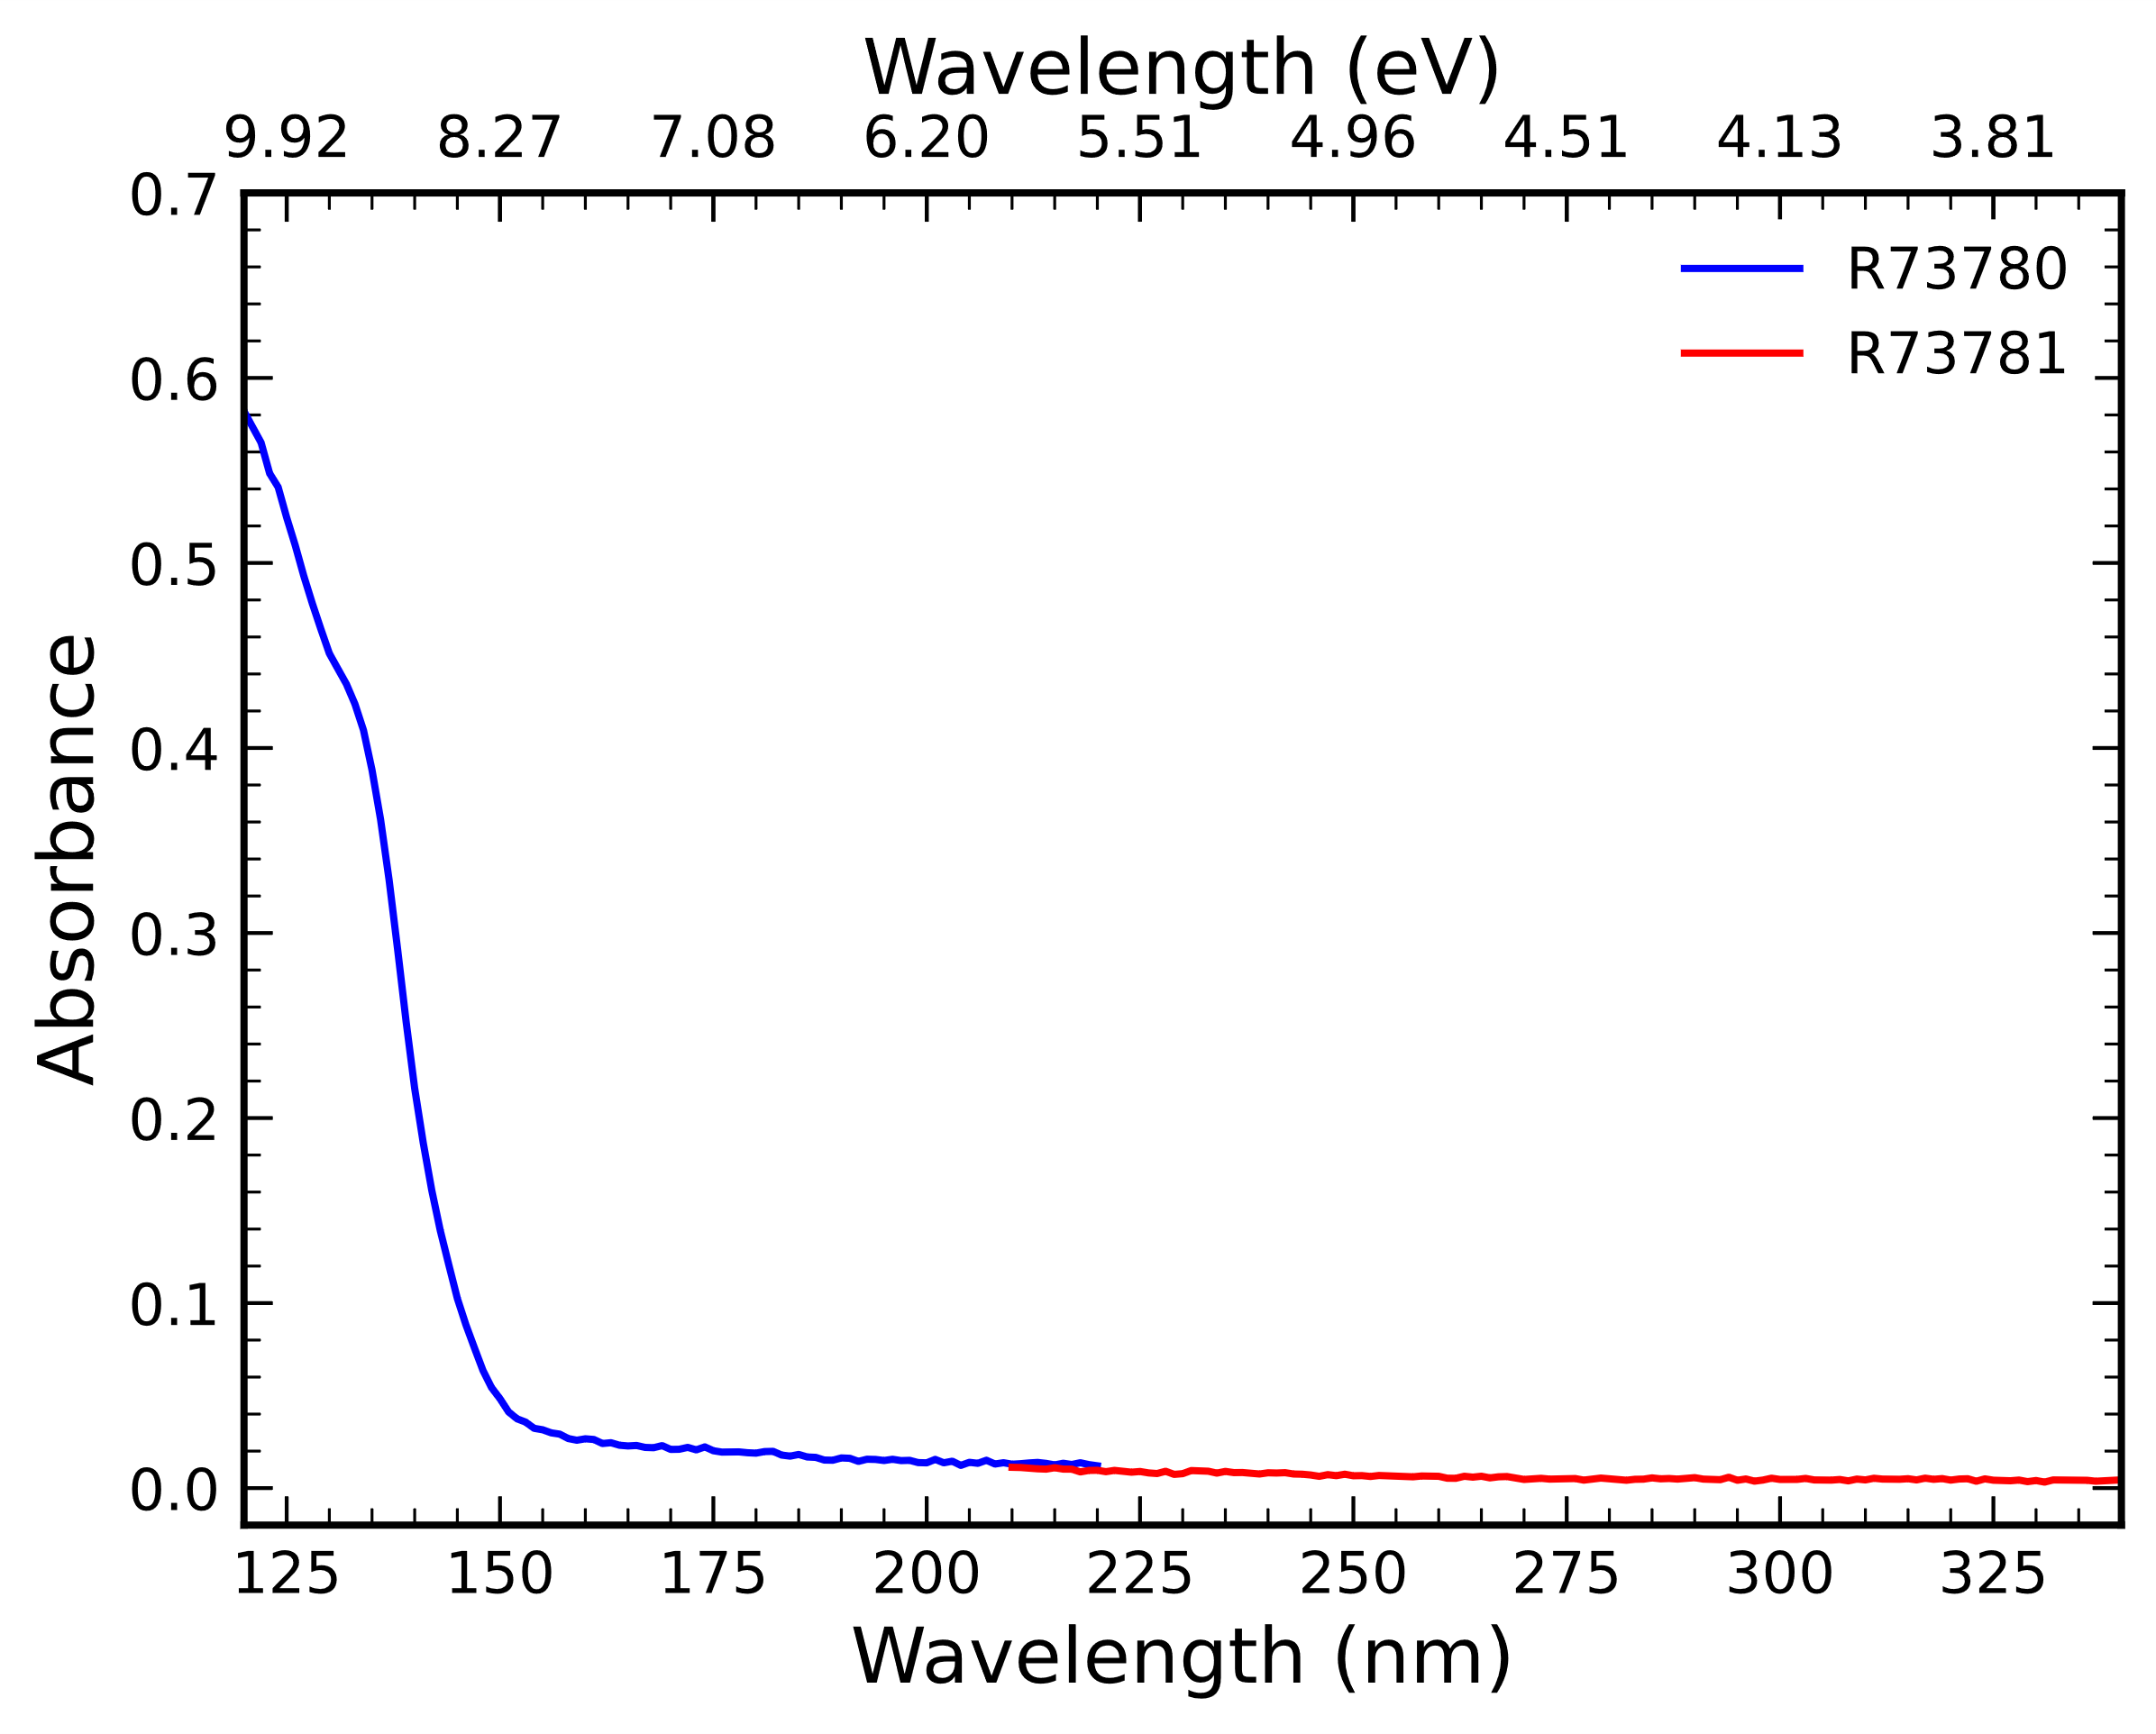
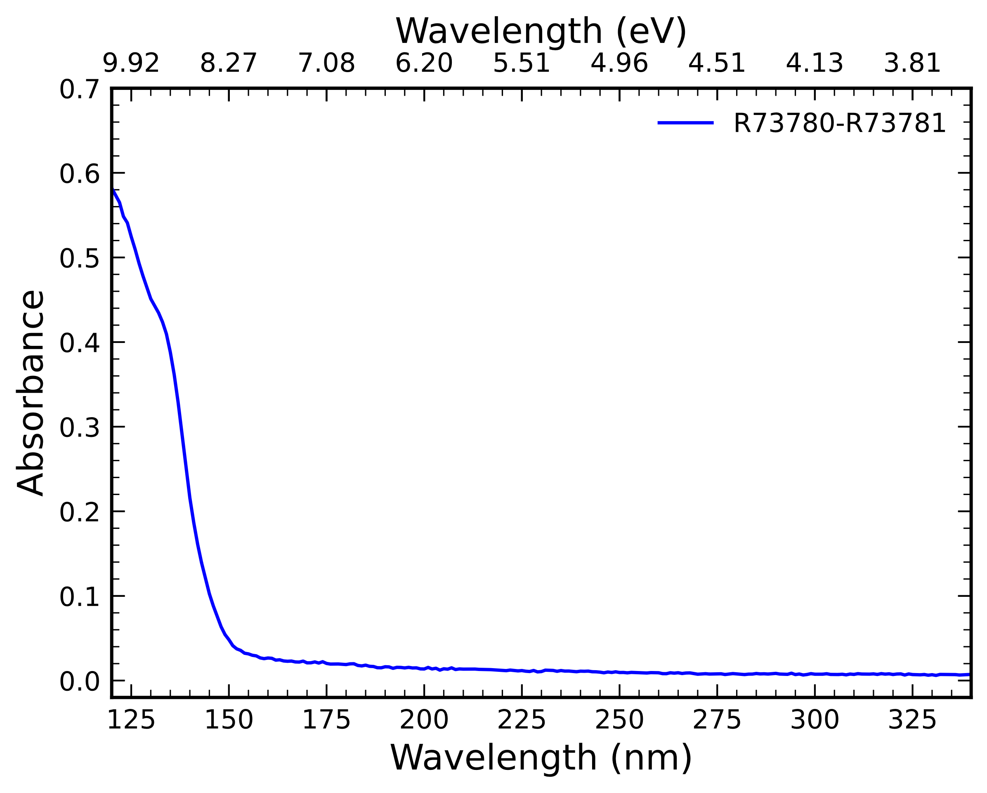
Two Spectrum Objects
A StitchedSpectrum Object
There will be more information about how these are made very soon!

Slide 11
Usage Examples

Slide 12
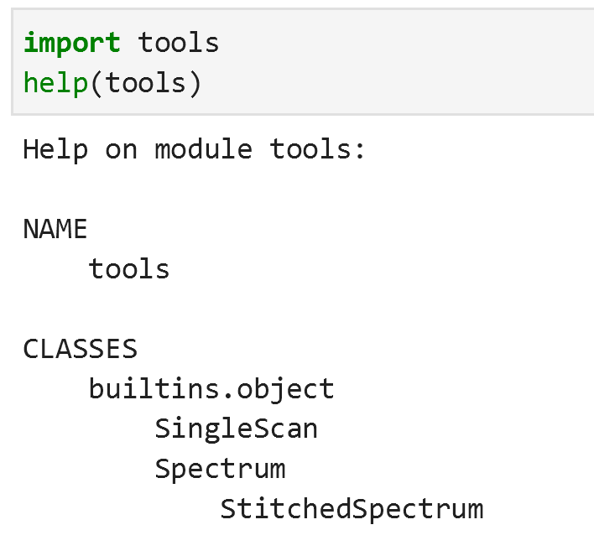
The tools module
It’s not actually a package yet, just a python file
If you have tools.py in your working directory, you can import it and get access to its classes and methods
It has three classes: SingleScan, Spectrum, and StitchedSpectrum
We will look more closely at the classes later

Slide 13
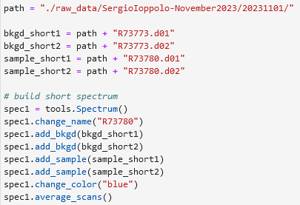
Example – Reading Data
Find the right files
Make a Spectrum object
Add background files
Add sample files
Average the scans together

Slide 14
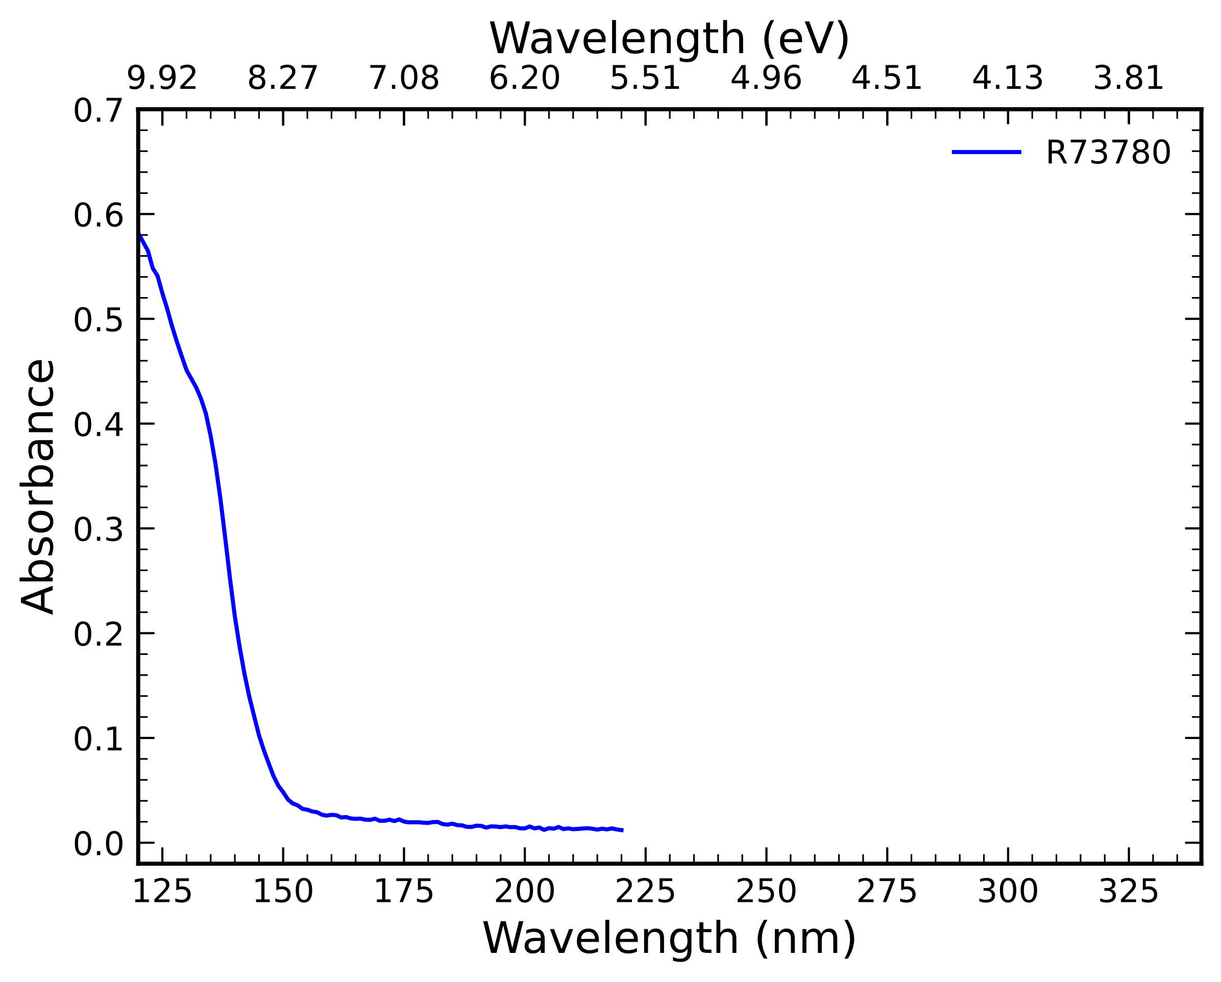
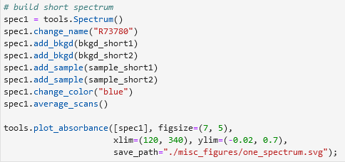
Example – Plotting Spectrums

Slide 15
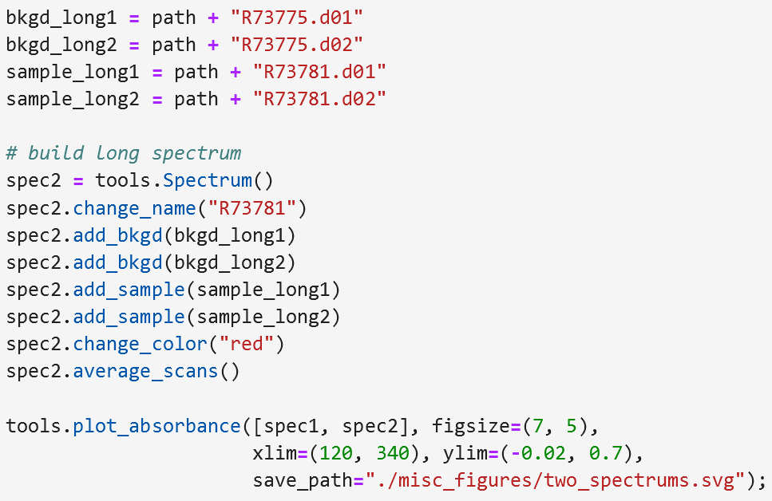
Example – Plotting Spectrums
plot_absorbance() takes a list of Spectrum objects. You can plot as many as you like.

Slide 16
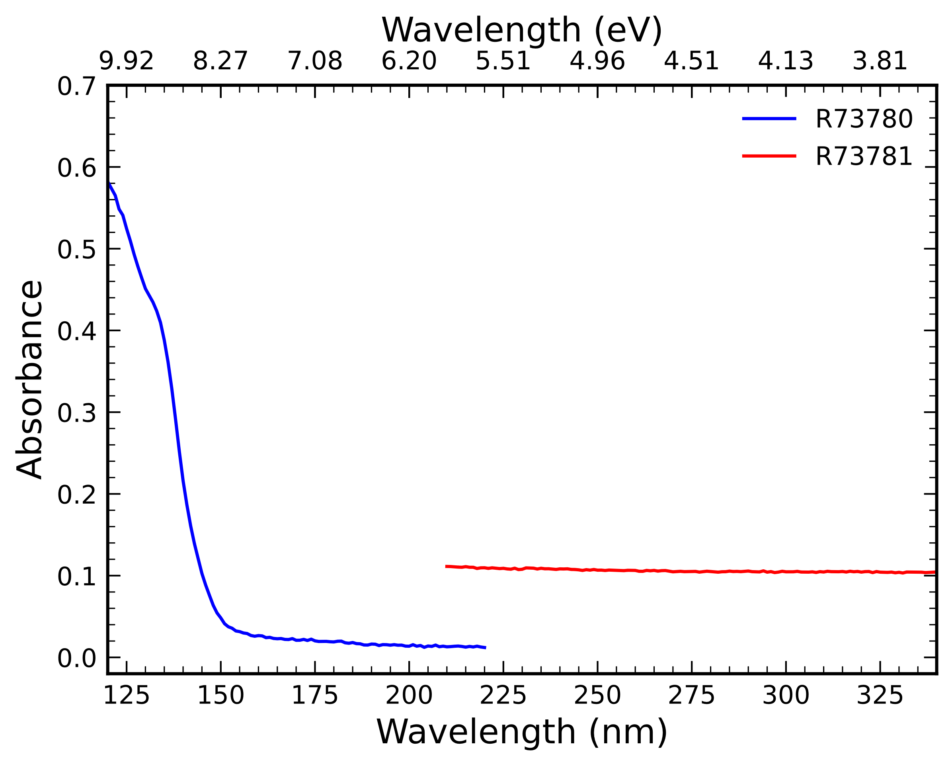
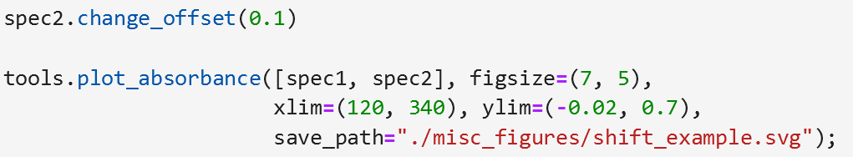
Example – Shifting Spectrums
Spectrums can be shifted vertically using the change_offset() function.
The original data are preserved; the shift is applied separately when calculations are performed, so that it can easily be changed without losing information.

Slide 17
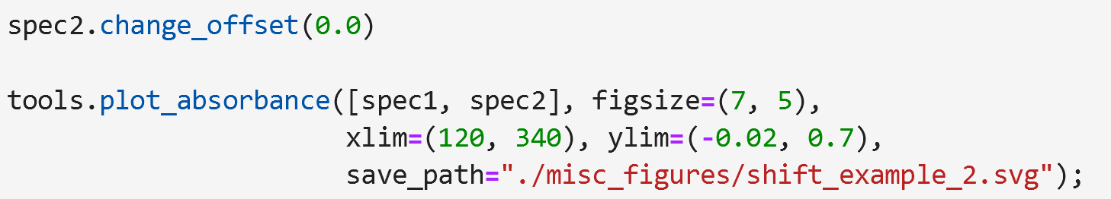
Example – Shifting Spectrums
The offset value is always with respect to the original position of the data, not the previous offset.
Changing the offset from 0.1 to 0 returns the red spectrum to its original position in the plot.
Changing the offset from 0.1 to -0.1 would shift the red spectrum by -0.1 from its original position.

Slide 18
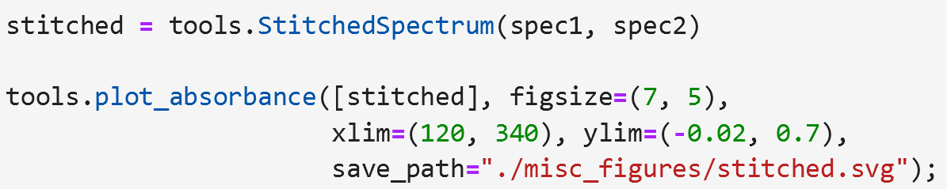
Example – Stitching Spectrums
Shifting spectra manually is not robust and should only be done for visualization purposes. Combining Spectrums is done properly by making a StitchedSpectrum object.
Essential Steps:
Have two Spectrum objects
Stitch them
(you can in principle combine two StitchedSpectrum objects too, but that is untested!)

Slide 19
Changes made when making a StitchedSpectrum
The color of the first Spectrum is carried forward. The names are hyphenated. These can be changed afterwards with the change_name() and change_color() methods if desired, just like a regular Spectrum object.

Slide 20
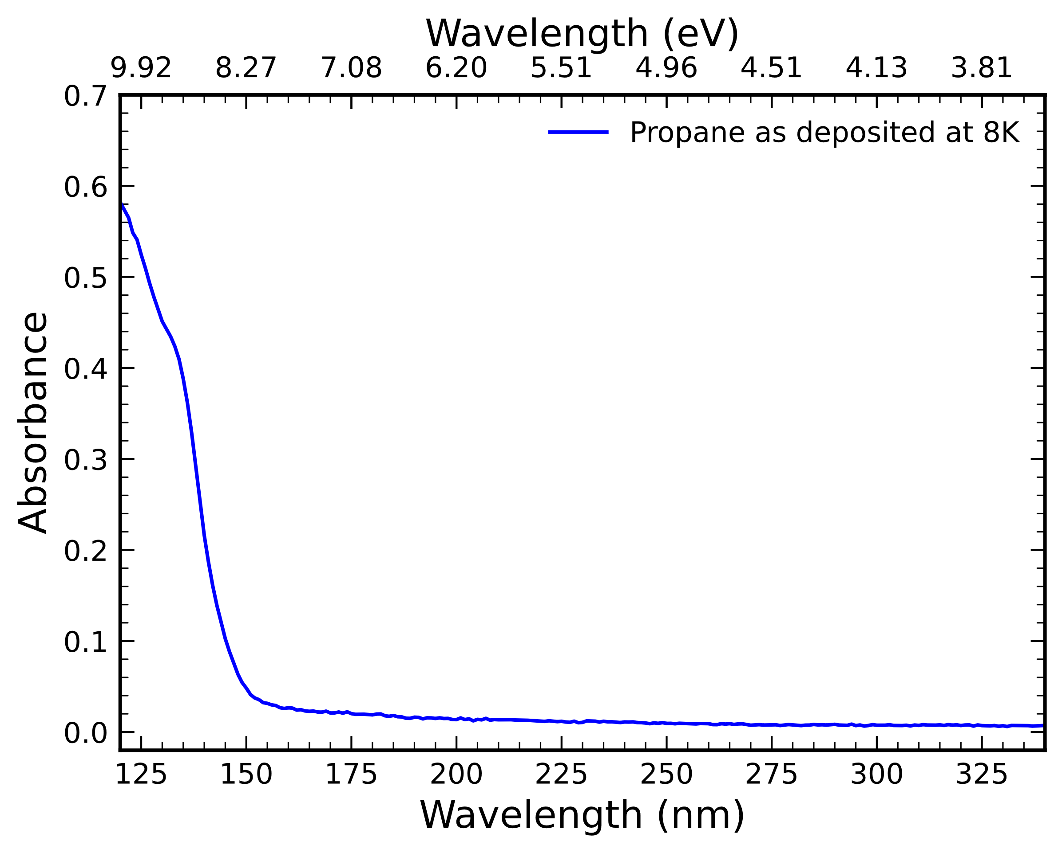
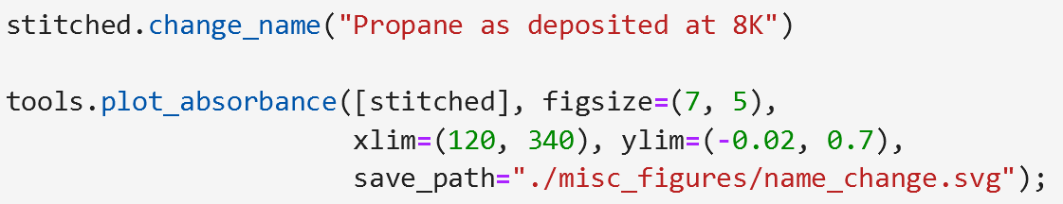
Example – Changing Names
Names are changed with the change_name() function

Slide 21
Example - Changing Colors

Slide 22
Example – Fitting Data with Gaussians

Slide 23
Example – Fitting Data with Anything

Slide 24
Example – Extracting Fit Information

Slide 25
Example – Exporting Data

Slide 26
Programming Details

Slide 27
Object-Oriented Approach

Slide 28
Classes

Slide 29
SingleScan Class

Slide 30
Spectrum Class

Slide 31
StitchedSpectrum Class

Slide 32
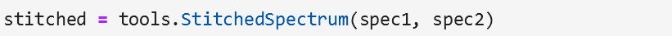
The Stitching Algorithm
Stitching is fully automatic and requires no effort on your part
The two Spectrums being stitched (spec1, spec2) must have some overlap in wavelength data
Creating a StitchedSpectrum object from two Spectrum objects:
Finds the overlapping region
Finds the average difference between absorbance values in the overlapping region
Shifts the second Spectrum by that value. Now the average difference in absorbance values is zero
Averages the absorbance values in the overlapping region together
Combines the first Spectrum, the overlapping region, and the second Spectrum’s data into one
The StitchedSpectrum class extends the Spectrum class. That is to say, a StitchedSpectrum has all the same properties as a Spectrum

Slide 33
Potentially Important!
By averaging the overlapping region together, we are changing the signal to noise ratio in that region. Signal scales linearly with the number of observations, while noise scales as the square root of the observations. This can create an apparent smoothing in the stitched region. The effect is small, but present.
Notice how this region has less visible noise than surrounding regions

Slide 34
Plotting Functions

Slide 35
Fitting Function

